Slide 1
Data Organization and Retrieval (Memory / Container Implementation)
Subhasis Bhattacharjee
Computer Science & Engineering, IIT Jammu

Slide 2
Outline
Storage / Memory for data structures
Basic forms of memory allocation
Contiguous
Linked
Indexed
Prototypical examples of these: arrays and linked lists
Other data structures:
Trees
Hybrids
Higher-dimensional arrays

Slide 3
Memory Allocation
Memory allocation can be classified as either
Contiguous
Linked
Indexed
Prototypical examples:
Contiguous allocation: arrays
Linked allocation: linked lists

Slide 4
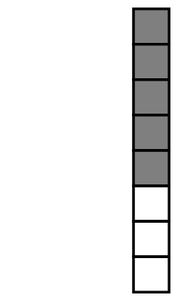
Contiguous Allocation
An array stores n objects in a single contiguous space of memory
If more memory is required, a request for new memory usually requires copying all information into the new memory
In general, you cannot request for the operating system to allocate to you the next n memory locations

Slide 5

Linked Allocation
Linked storage of two pieces of data
The object itself, and
A reference to the next item
In C++ that reference is the address of the next node

Slide 6
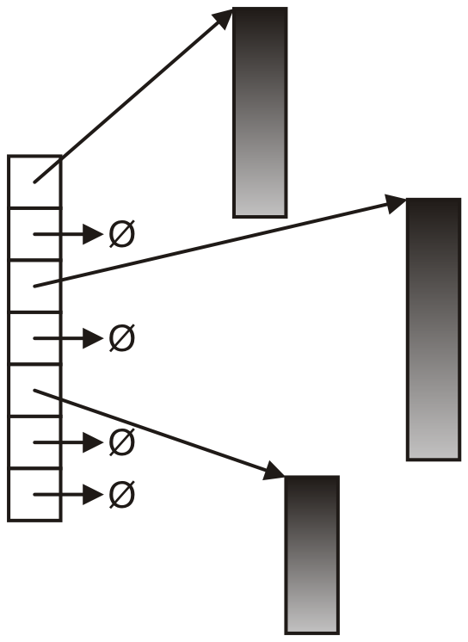
Indexed Allocation
An array of pointers (possibly NULL) link to a sequence of allocated memory locations
Used in the C++ standard template library
Page table, Cache table in operating systems

Slide 7
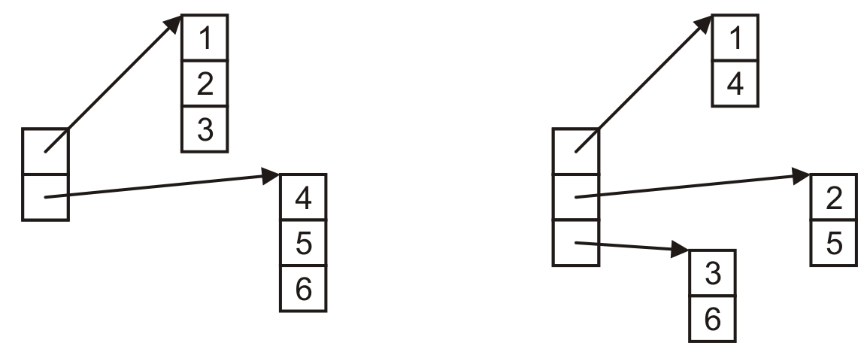
Indexed Allocation (example)
Matrix can be implemented using indexed allocation:

Slide 8
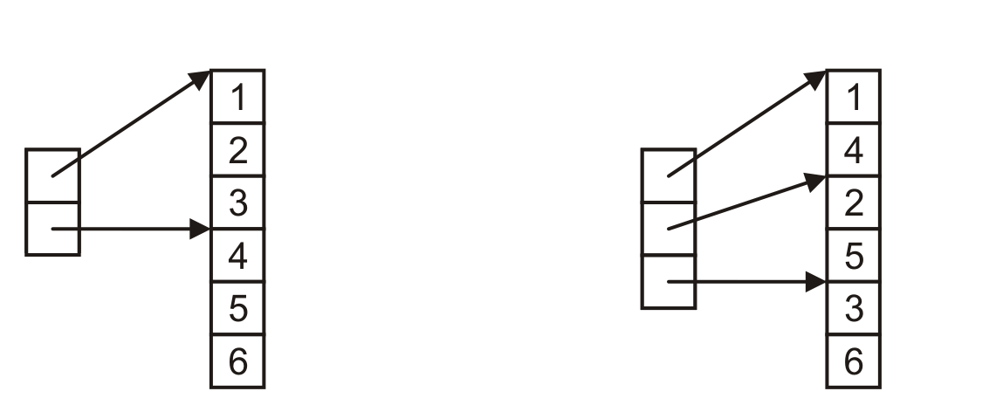
Indexed Allocation (Matrix)
Generally matrices (or higher-dimensional arrays) use indices pointing into a single contiguous block of memory
Row-major order
Column-major order
C, Python
Matlab, Fortran

Slide 9
Other Allocation Formats
Some variations or hybrid of memory allocations:
Trees
Graphs
Deques (linked arrays)
inodes

Slide 10
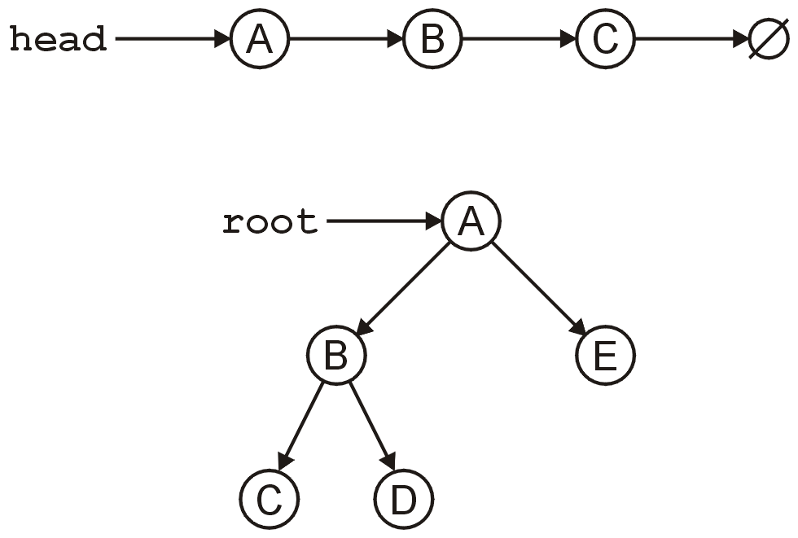
Tree
The linked list can be used to store linearly ordered data
What if we have multiple next pointers?
A rooted tree is similar to a linked list but with multiple next pointers

Slide 11
Memory Allocation for Tree
A tree is a variation on a linked list
Each node points to an arbitrary number of subsequent nodes
Useful for storing hierarchical data
Usually we will restrict ourselves to trees where each node points to a fixed number of other nodes
Binary
Two-three-four tree
B-tree, B+-tree

Slide 12
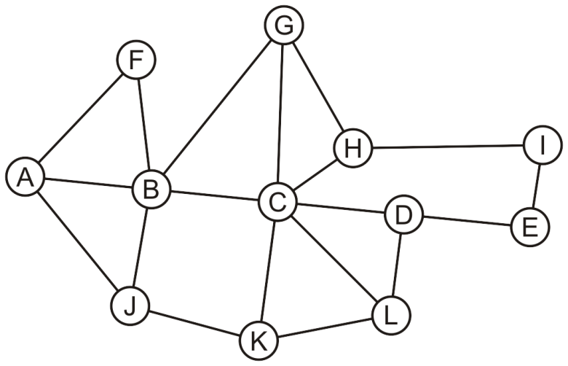
Graph
Suppose we allow arbitrary relations between
any two objects in a container
Given n objects, there are n² – n possible relations
If we allow symmetry, this reduces to (n² – n)/2

Slide 13
Memory for Graph – 2D Array
Using a two-dimensional array (contiguous memory)
Row-Major or Column-Major order
 | A | B | C | D | E | F | G | H | I | J | K | L
A |  | × |  |  |  | × |  |  |  | ×
B | × |  | × |  |  | × | × |  |  | ×
C |  | × |  | × |  |  | × | × |  |  | × | ×
D |  |  | × |  | × |  |  |  |  |  |  | ×
E |  |  |  | × |  |  |  |  | ×
F | × | ×
G |  | × | × |  |  |  |  | ×
H |  |  | × |  |  |  | × |  | ×
I |  |  |  |  | × |  |  | ×
J | × | × |  |  |  |  |  |  |  |  | ×
K |  |  | × |  |  |  |  |  |  | × |  | ×
L |  |  | × | × |  |  |  |  |  |  | ×

Slide 14
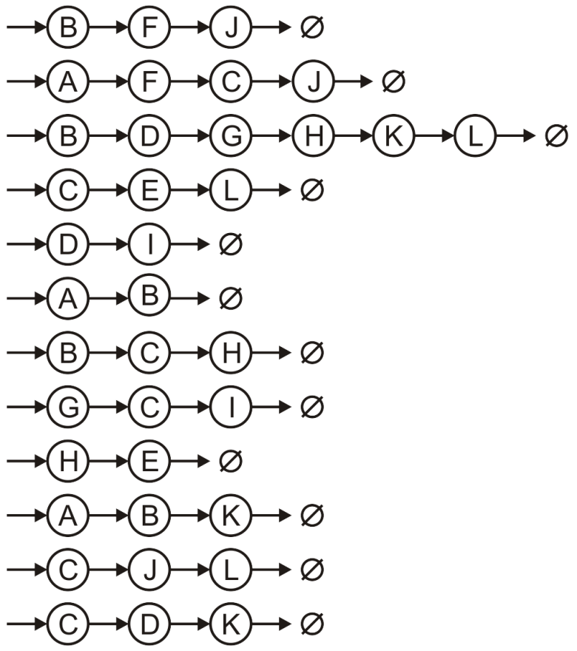
Memory for Graph – Array of Linked Lists
Using a hybrid: an array of linked lists (hybrid of contiguous memory and linked memory)
A
B
C
D
E
F
G
H
I
J
K
L

Slide 15
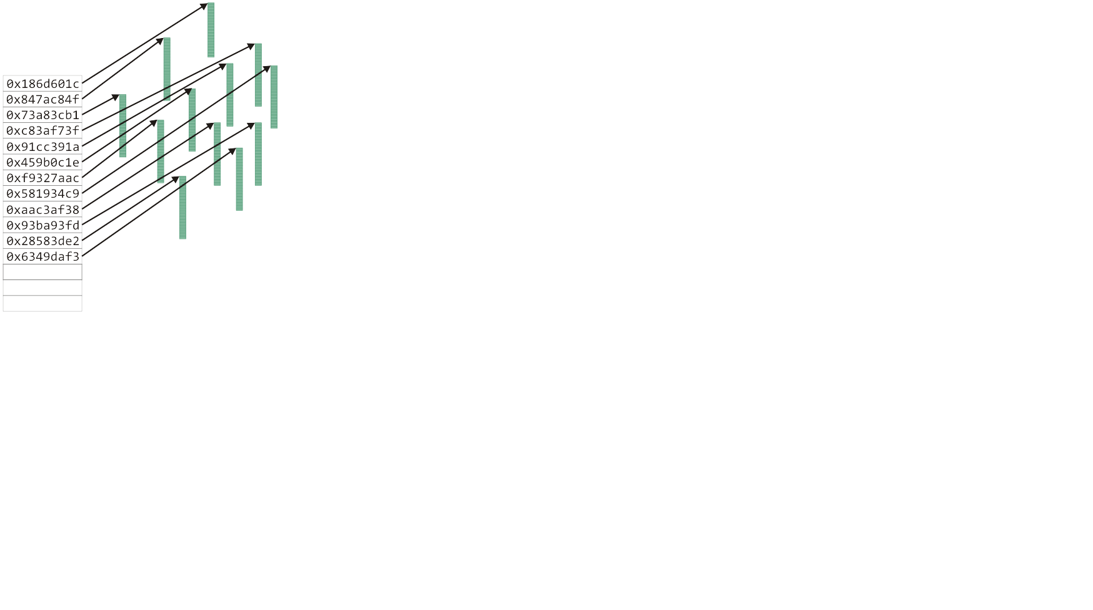
Hybrid Memory Allocations – Unix – 1
The Unix inode is used to store information about large files
The first twelve entries can reference the first twelve blocks (48 KiB)

Slide 16
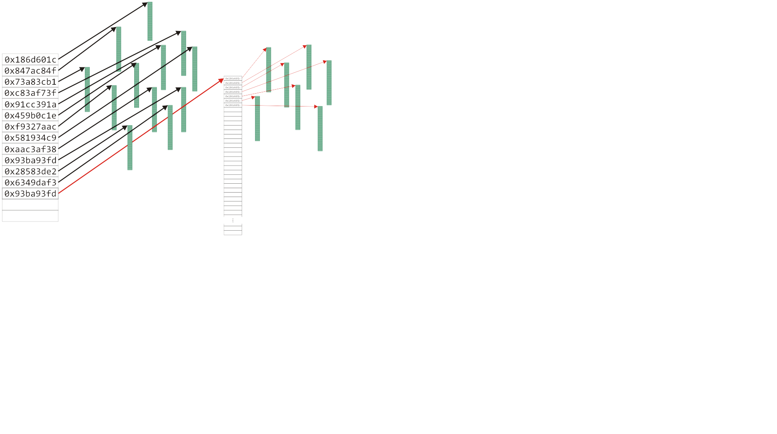
Hybrid Memory Allocations – Unix – 2
The next entry is a pointer to an array that stores the next 1024 blocks

Slide 17
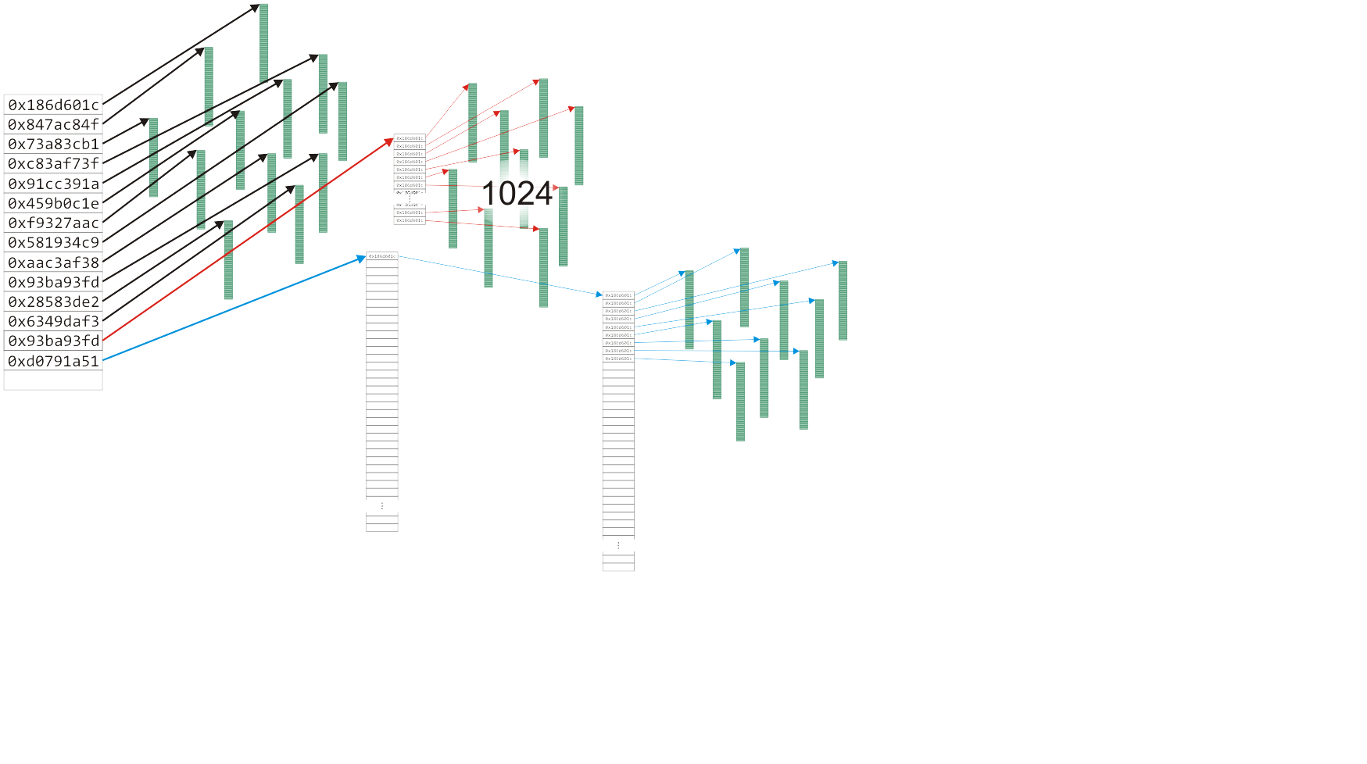
Hybrid Memory Allocations – Unix – 3
The next entry has two levels of indirection for files up to 4 GiB

Slide 18
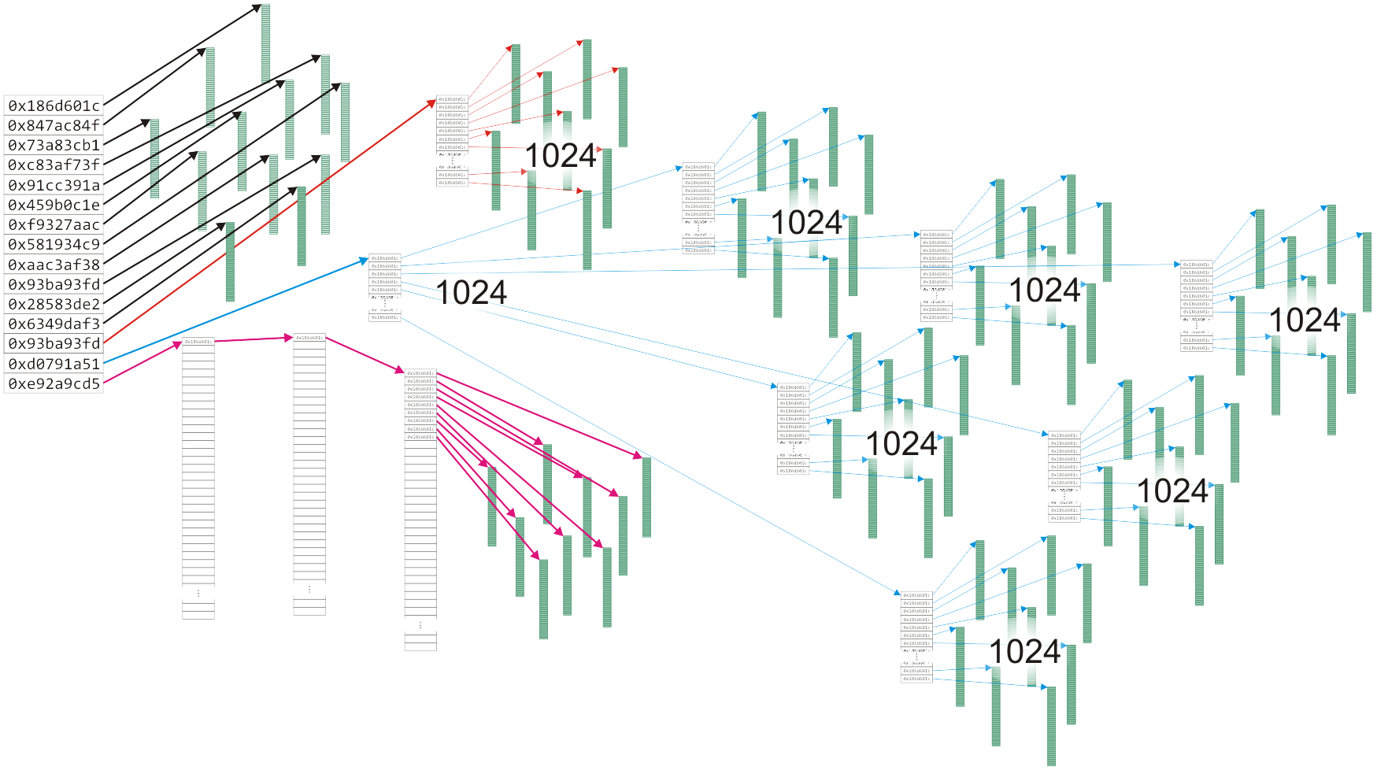
Hybrid Memory Allocations – Unix – 4
The last entry has three levels of indirection - files up to 4TiB

